Slide 1
Validate the Value
SJEMCDEV01 As of 2015-02-01

Slide 2
Project Objectives
Systems Engineer insert project objectives from pre-sales proposal
Example #1 - Reduce 3 year total cost of ownership
Example #2 - Increase application and database performance levels
Example #3 - Simplify and automate storage provisioning tasks
Example #4 - Increase accuracy of infrastructure spend forecasting
Notes:
Send feedback on this template to jason.jones@emc.com and justin.mirsky@emc.com.
Validate the Value – Client presentation delivered after solution installation which leverages metrics to validate the solution meets or exceeds the business and technical expectations set during the sales campaign
Note to Presenter – The purpose of this template is to provide you with a framework to build an impactful validate the value presentation. Some content is automatically populated by Mitrend. The rest of the content needs to be populated by you. Most of the content that needs to populated can be found in your pre-sales proposal. Note this PowerPoint is meant to be a framework. If your solution includes other technologies that should be included feel free to modify this presentation as needed.
----
Project Objectives Slide:
List pre-sale project objectives in this slide. Recommendation is to take project objectives from proposal and copy/paste into this slide. Some examples are provided in the slide.

Slide 3
SJEMCDEV01 Before IT Investment
Systems Engineer: Insert before environment diagram from pre sales proposal or EMC visio desk
Notes:
Before IT Investment Slide:
Populate this slide with the before environment diagram from your pre-sales proposal or EMC visio desk.

Slide 4
Pre-Sales Performance Data Collection
Systems Engineer: Insert Relevant Performance Data Collection Results, such as:
EMC Storage System IOPS, Response Time, Heatmap
Server IOPs and Response Time
3rd party storage system IOPs and response time
Reference notes section of this slide

Slide 5
SJEMCDEV01 After IT Investment
Systems Engineer insert after environment diagram from pre sales proposal or EMC visio desk

Slide 6
Solution Benefits
Business Benefits
Systems Engineer: insert business benefits here
Example - FAST Suite reduced 3 year total cost of ownership by 30%
Example - Reporting cycles reduced by 50% enables business to make quicker decisions
Example - Reduction in application deployment cycle enables business to be more agile
Example - ViPR self service catalog increased productivity of application team by reducing provisioning time
Technical Benefits
FAST Suite services 72% of transactions using flash drive technology, at an average service time of 1 ms.
Flash drives comprise 0.96% of system capacity and support 72% of IO.
Hard drives (FC, SAS and/or NLSAS) comprise 99.04% of the total raw capacity.
Notes:
Solution Benefits Slide:
Please populate the business benefits section with business benefits realized from solution. Business benefits are usually associated with increased productivity (increases revenue), cost reduction, and risk mitigation. Focus on your audience and tailor the benefits to your customer. Here are a few examples. If presenting to a C level audience focus on how the new solution lowered cost per TB vs. business as usual or focus on how the new solution enables the business to generate reports faster, improving business agility. If presenting to a director of applications focus business benefits on how the solution reduced application latency which increased application owner productivity. If presenting to a director of IT focus on how the solution simplified operational tasks for infrastructure engineers.

Slide 7
System Asset List
The following systems were analyzed for this assessment:
Name | Model | Serial Number
APM00140712253 | VNX5800 | APM00140712253

Slide 8
EMC ViPR SRM
Provides topology map of infrastructure including databases, servers, connectivity, and storage
Reduced time to root cause connectivity issues from X to X hours
Enables chargeback, capacity, and performance trending across databases, servers, connectivity, and storage
Simplifies and increases forecasting accuracy of infrastructure spend
Provides ability to audit infrastructure against EMC support matrix
Mitigate risk of downtime associated with interoperable infrastructure software

Slide 9
EMC ViPR Storage Controller
Storage-As-A-Service
Enabled defined application workload’s storage requirements in a software defined storage catalog
X self service catalog storage offerings drive consistency across IT infrastructure
The following business units have access to ViPR to request storage services: SEInsertBusinessUnitHere
Storage Automation
Storage provisioning has been reduced down to 5 clicks across all arrays
63% average reduction in time for an administrator to provision storage
Average Time Reduction by Platform
74%: VNX Block, 48.4%: VNX File
86.5%: VMAX Block
60.5%: Isilon File
45.6%: NetApp File

Slide 10
Workload Profile
Date Time | Front End IOPS | Front End MBps | Read % | Avg Read Size (KB) | Avg Write Size (KB)
2015-01-31 14:09:51 | 8,123 | 281 | 51 | 32 | 39
2015-01-31 20:24:51 | 7,962 | 232 | 46 | 28 | 31
2015-01-31 22:59:52 | 10,384 | 353 | 49 | 31 | 39
2015-01-31 23:19:51 (95th) | 8,037 | 217 | 49 | 25 | 30
Three peak values have been selected to illustrate the busiest time periods.
Notes:
The graph in this Workload Profile Slide illustrates the Front End IOPS as presented over a period of time. The table illustrates the Peak metrics at several points in time. This is meant to illustrate that different Metrics can peak at different times depending on the workload.

Slide 11
VNX Summary
Name | Model | # SPs | # Ports | # of Bound Disks (non-EFD) | # of Bound EFDs | # RAID Groups
APM00140712253 | VNX5800 | 2 | 24 | 97 | 9 | 0
Notes:
VNX Summary Slide:
Note the total IOPs and response times metrics. These metrics should be compared against the pre-sales performance data collection. If response times have been reduced or IOPs have increased identify this as a benefit. More transactions in less time can equate to higher business productivity levels. If total IOPs and response times have remained constant this is ok as FASTVP has reduced total cost of ownership. In other words obtaining the same performance levels and reducing cost is a business benefit. If response times have increased slightly but still acceptable with application owners there is no need for concern. If response times are higher than expected and impacting application performance this is an opportunity to determine if a discrepancy exists between pre-sales performance data collection and current performance workload.

Slide 12
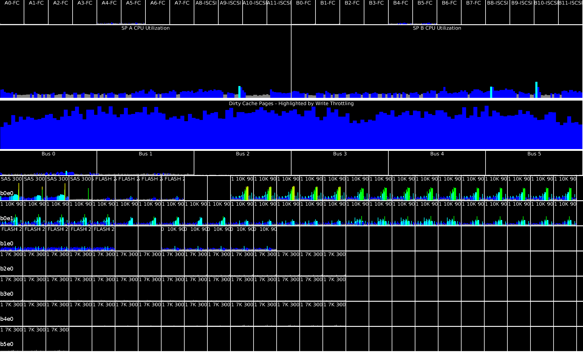
Value of VNX Hardware Architecture
Message
Business Benefit– Storage Processor utilization indicates system will support additional applications and future growth
Notes:
Value of VNX Hardware Architecture Slide:
This slide comments on the storage processor utilization levels in the system. If utilization levels are low it proves the system has the capability to support additional application growth. If utilization levels are moderate this proves the client is getting good value out of the system and may be able to support additional applications depending on their performance profile. If utilization levels are moderately high this is an opportunity to compare pre sales performance data collection data to post sales data and determine what discrepancies if any exist. If other components (cache or drives) are over utilized and storage processor utilization is ok there is an opportunity to discuss drive upgrades to reduce component utilization.
Note the following logic is used to determine classification of storage processor utilization.
If the average of storage processor A and B’s 95th percentile utilization levels is 50% or less then mitrend will state
Business Benefit – Storage Processor utilization indicates system will support additional applications and future growth
If the average of storage processor A and B’s 95th percentile utilization level is between 70% and 50% mitrend will state
Observation – System services application transactions with moderate storage processor utilization levels.
If the average of storage processor A and B’s 95th percentile utilization level is over 70% mitrend will state
Observation – System services application transactions with moderately high storage processor utilization levels
Rockies
Color key:
Blue: 0-19% utilization
Cyan: 20-39% Utilization
Green: 40-59% utilization
Yellow: 60-79% utilization
Orange: 80-89% utilization
Red: 90-100% utilization
Top row shows port utilization, as a percentage of max bandwidth / port bandwidth. Port bandwidth is based on the currently negotiated bandwidth: ports may be capable of higher throughput. Max Bandwidth is the maximum of read or write bandwidth: this shows the maximum utilization in either direction.
The second row shows the SP Processor Utilization.
The third row depends on the FLARE Operating Environment version running on the system
For pre-OE 33 (pre-VNX2) environments, this section shows the SP Dirty Pages Utilization %. Each SP maintains a separate cache, therefore two caches are shown
For OE 33 (Rockies) and above, the SP Caches are unified, therefore the total SP Dirty Pages in MB is shown (the maximum of the values from each SP). The SP Dirty Pages are color coded according to the amount of Write Throttling: fewer than 10 write throttles per sec = blue, up to 50 then cyan, up to 100 then green, up to 200 then yellow, over 200 then orange.
These write throttle thresholds are chosen arbitrarily, to show the amount of cache activity within the system. It's expected and normal that a busy system will show more requests than an idle system
The fourth row shows bus utilization. This is calculated using the total disk bandwidth (MB/sec) for all disks on a given bus, and assumes a 4Gb/sec bus speed for CX systems and 6x4 Gb/sec bus speed for VNX systems. If the model is undetected, the model is assumed to be a CX.
The final set of rows shows disk utilization for each individual disk. Each disk is identified by three indicators: Raid Group, Speed, and Size. FC for the Raid Group value indicates a FAST Cache device. Each row represents a bus and target, identified by the leftmost label: b0e1 is Bus 0, Enclosure 1

Slide 13
Value of FAST Suite
Business Benefit: Lower TCO and increased application performance
Technical Benefit: Flash drives comprise 0.96% of system capacity but support 72% of total IOPS with 1ms avg response times.
Drive Type | # Disks | % of IOPS | Raw Capacity (TB) | Raw Capacity (%)
FLASH | 9 | 72 | 2 | 1
SAS | 4 | 4 | 1 | 1
SAS | 45 | 23 | 36 | 22
NL | 48 | 0 | 129 | 77
 | 106 | 100 | 168 | 100
Notes:
Value of FAST Suite Slide:
This slide will call out technical and business benefits realized from VNX FAST Suite. Its important to emphasize the capacity to performance ratio of the different tiers.

Slide 14
5 Year Growth Projections
At 30% growth, usable capacity will be exceeded in less than 4 year(s).
Notes:
This slide displays the system’s current consumed capacity level in TB and graphs growth using different growth percentage rates including IDC standard of 20%. In addition, this slide estimates the expected time frame for an upgrade by using the IDC growth rate and system’s total usable capacity.

Slide 15
LUN Skew - Front-End IOs
86% of IOPS are to 15% of LUNs
Notes:
This chart shows LUN Skew and NOT Sub-LUN Skew. This graph shows a high level view of skew and should be used to open a discussion around FAST and its benefits.

Slide 16
Observations
Existing Environment
Opportunity to reduce application latency
Upcoming Projects
Hybrid cloud Initiative
Virtual desktop Initiative
Data analytics Initiative
Database Optimization
Data Center Consolidation
Solution Options
EMC Hybrid Cloud - EMC Consulting
ViPR and ViPR SRM
XtremIO
Isilon
EMSD
Notes:
Observations Slide:
The purpose of this slide is to identify areas where EMC and the partner community can help the client's business. Recommendations can be VNX or non-VNX related. In addition, recommendations can be based off this assessment or from a conversation with the client. Some questions to ask yourself and topics to consider when adding content to this slide include.
Is a VNX hardware or software upgrade necessary?
Are there applications in the environment (e.g. VDI, SQL, Oracle) that could benefit from a flash solution like XtremIO or XtremSW/SF?
What is the 1, 3, 5 year roadmap look like for the environment?
Is there a cloud initiative and/or ITaaS for this environment?
Would this business see value in EMC application consulting or residency services?
What are the critical business applications?
What percentage of servers are virtualized in the environment?
Are RPO and RTO requirements being met today?
What is the BC and DR strategy and has it been tested?
Does the business see value attending an Executive Briefing?

Slide 17
Thank You

